Slide 2
El mundo al revés: Bash en Windows y PowerShell en Linux
Diego Martinez
Technical Evangelist
diego.martinez@microsoft.com
@diegomrtnzg

Slide 3

Diego Martinez
Technical Evangelist
Developer eXperience @ Microsoft
OSS, DevOps, Cloud and Infrastructure
Academic
Contact
diego.martinez@microsoft.com
@diegomrtnzg

Slide 4
WARNING All features you will see are in preview

Slide 5
Agenda
Microsoft loves Linux
Don´t fight. Better together
Bash on Ubuntu on Windows
It´s real. Develop your apps where you want
PowerShell on Linux
Windows admins: manage Linux as a Windows in the same way
Microsoft OSS
We are really involved in Open Source world
Q&A

Slide 6
Microsoft Linux

Slide 7
Bash on Ubuntu on Windows

Slide 8
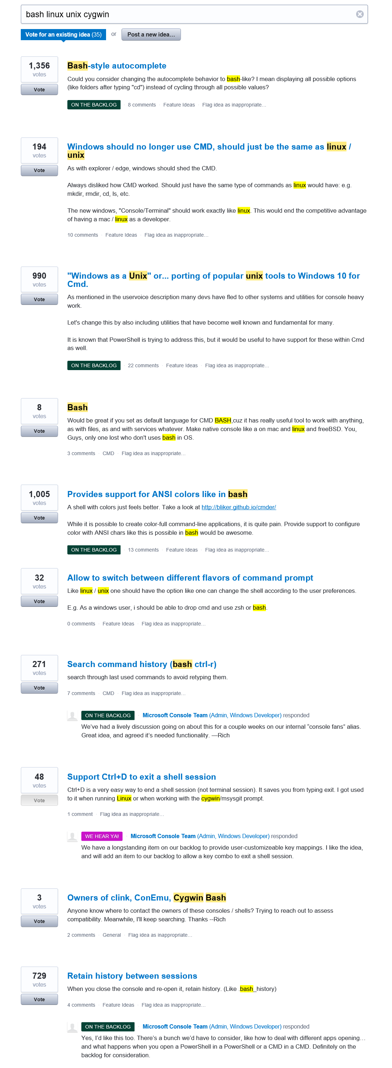
Response to feedback
Feedback on the Windows command-line
https://wpdev.uservoice.com/forums/266908-command-prompt/filters/top
Two themes emerged
Improve the Windows Console
Bring Unix/Linux tools to Windows
Bash, ssh, grep, sed, awk, etc.
Better support platforms used by OSS projects (esp. Ruby, Python, etc.)

Slide 9
Why *NIX tools on Windows? We live in a heterogenous world
Windows and Linux are more prevalent than ever before
Many open source projects depend on Linux features
We want Windows to be the place for you to do ALL your work
All the platforms
All the devices

Slide 10
The solution
Integrate *NIX tools and environment into Windows
Run native Linux binaries on Windows
No VMs – real Linux tools
On Windows. In Windows. Together.
Bash on Ubuntu on Windows
Windows Subsystem for Linux (WSL)
New distro-agnostic, Linux compatible subsystem

Slide 11
Demo Bash on Ubuntu on Windows

Slide 12
What did we just see?
Linux tools
Linux ELF64 binaries
Running directly on …
Windows subsystem for Linux
New feature in the Windows kernel
Exposes a Linux-compatible syscall layer and process model
Supports fork() and many Linux syscalls
User-mode
Ubuntu
Bash, git, Ruby, etc.
Windows Kernel
Kernel
Windows Subsystem for Linux
Syscalls
read
write
open
fork
…

Slide 13
What works … and what doesn’t?
This is a preview of a brand new technology
THERE WILL BE GAPS!
Many of your favorite Linux tools Work Well In Testing
Bash, apt-get, Ruby, Git, Python…
Known issues
Top – not working yet!
MySQL has issues
We’re working hard to close gaps
MANY scenarios are untested …

Slide 14
Community
More info
https://blogs.msdn.microsoft.com/wsl/
Documentation
https://msdn.microsoft.com/commandline/wsl/about
UserVoice (Ideas & asks)
https://wpdev.uservoice.com/forums/266908-command-prompt/filters/top
Feedback
https://github.com/ethanhs/WSL-Programs

Slide 15
PowerShell on Linux and MacOS

Slide 16
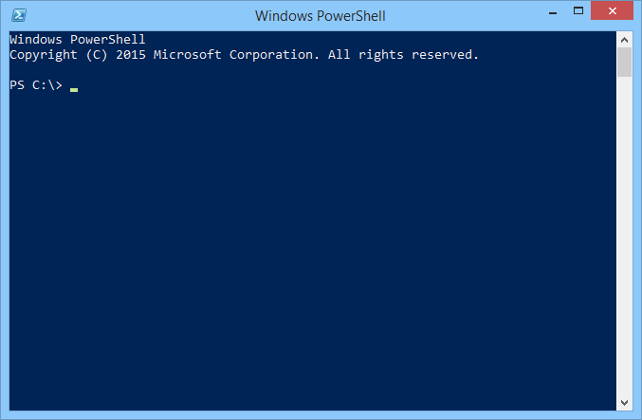
What is PowerShell?
Task-based command-line shell and scripting language built on the .NET Framework.
Help IT professionals control and automate the administration of Windows (and now Linux) and the apps that run on them

Slide 17
What is the PowerShell journey?
PowerShell is built on .NET
You can only use in Windows
.NET Core change the scenario
We port it to Linux (alpha version)
Same tool to manage everything from anywhere
Windows + Linux + new users can use:
Interactive scripting language
Heterogeneous automation
Configuration management
Interoperates with other tools

Slide 18
Is it the same PowerShell? No, we add some changes
PowerShell Editor Services
You can choose your editor: VS Code, Sublime…
Coming soon: OpenSSH as a native transport
You can choose SSH or WINRM as a transport

Slide 19
Demo PowerShell on Linux

Slide 20
PowerShell DSC for Linux
Configuration management platform
Extend PowerShell functionality
Deploy and manage configuration data for software services and their environment
Features
Server SO
Built-In resources: nxArchive, nxEnviroment, nxFile, nxGourp, nxScript, nxUsers…
Distributing configurations modes: Push (WS-Man) and Pull (HTTP/HTTPS)
Protection against configuration drift

Slide 21

PowerShell + OMS
Operations Management Suite
Cloud management solution
Visibility and control applications and workloads across cloud and on-premise
OMS Automation
Highly available and scalable management service
PowerShell + PowerShell DSC
More info
Track Windows Server 2016 – 17:00
Más allá de la monitorización – Analizando logs con OMS
Azure | AWS
Modern
management

Slide 22
What works … and what doesn’t?
This is a alpha version
THERE WILL BE GAPS!
Many of your favorite PowerShell tools Work Well In Testing
Shell, scripting, automation, linux utilities, modules: AWS, Azure…
Known issues
Sudo, exec, redirection issues, job control, remoting support, missing commands
We’re working hard to close gaps
MANY scenarios are untested …

Slide 23
Community
More info
https://blogs.msdn.microsoft.com/powershell/
Open Source
https://github.com/PowerShell/PowerShell
We need your help!
RFCs, issues and contributions
Also, we are working with Chef, AWS, VMWare, Google…
GitHub
https://github.com/PowerShell/PowerShell

Slide 24
Microsoft OSS

Slide 25
How Microsoft Works with Open Source
Use open source in Microsoft products
Ensure we have Microsoft “value add”
Contribute code as open source to the community
Engage constructively with the community
Operating systems: Linux is a 1st class citizen
Field sellers, support, and services ramp up

Slide 26
Microsoft is committed to Linux and open source
Linux is a real business for Microsoft
30%
25% of IaaS VMs in Azure are Linux
System Center manages hundreds of thousands of Linux/UNIX servers
Many enterprises and service providers
run Linux as a guest on Hyper-V
… and we’re been in a long open source journey!
System Center has managed Linux and
UNIX servers since 2009
Linux drivers for Hyper-V available since 2010
Azure IaaS has run
Linux VMs since
“day 1” in 2013
Linux and open source are a fundamental part of how we do business
Today

Slide 27










































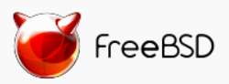

Azure is an open cloud
Public Cloud
DevOps
Clients
Management
Applications
PaaS &
DevOps
App Frameworks
& Tools
Databases &
Middleware
Infrastructure

Slide 28
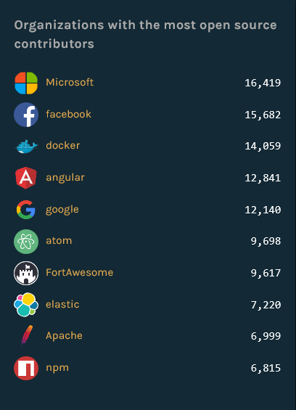
Microsoft and Open Source actual state The state of the Octoverse 2016
GitHub report
1st Organization with the most open source contributors
5th Repositories with the most open source contributors (VS Code)
https://octoverse.github.com/

Slide 29
Projects
Microsoft Edge’s JavaScript engine (ChakraCore)
Xamarin SDKs
.NET Core
Visual Studio Code
Bot Builder
TypeScript
and more…
https://github.com/Microsoft

Slide 30
Summary
Microsoft loves Linux
Don´t fight. Better together
Bash on Ubuntu on Windows
It´s real. Develop your apps where you want
PowerShell on Linux and MacOS
Windows admins: manage Linux as a Windows in the same way
Microsoft OSS
We are really involved in Open Source world

Slide 31

Q&A
http://aka.ms/mts73

Slide 32
Thanks!
http://aka.ms/mts73

